Slide 1
Team Members 1. Dawit Anbessie ………………….610521 2. Henok Damtew ………………...985772 3. Gizaw Dulecha ………………..108882 4. Zelalem Gelgelo ………………109695
SOFTWARE Engineering Project

Slide 2
Contents
Introduction
Use case diagram
Use case description
System architecture diagram
Key abstraction list
VOPC diagram
Sequence diagram

Slide 3
Introduction

Slide 4
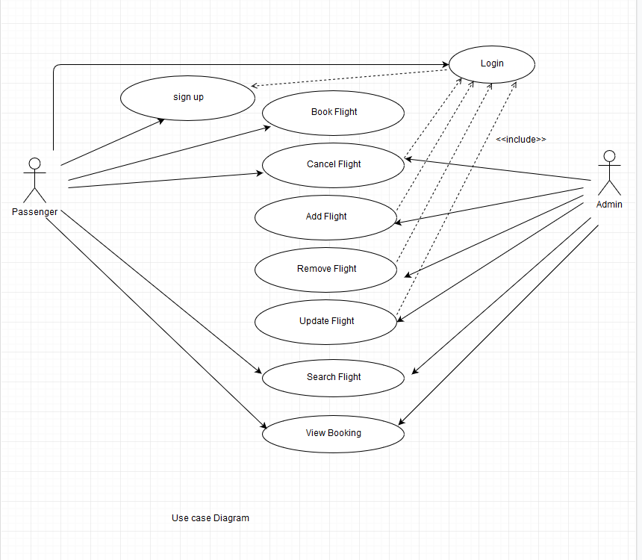
2.Use case diagram

Slide 6
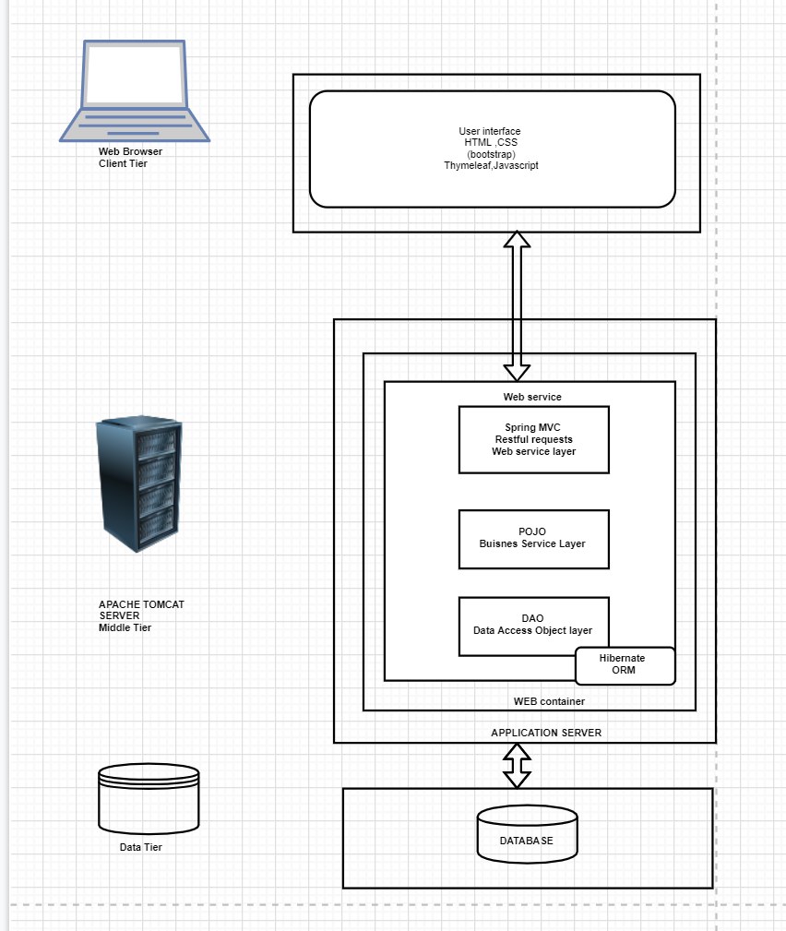
Architectural Design
System architecture diagram

Slide 7
Key Abstractions
User
Airline
Airplane
Booking
Airport
Flight

